Slide 1
JavaScript Functions
Hy-Tech Club: Web 201

Slide 2
Agenda
Defining Functions
Calling Functions
Callbacks

Slide 3

Defining a function
Notes:
Defining a function is like teaching your dog a trick (if your dog was a genius). It’s like saying “when I say fetch, you should find the ball, grab it, and return it to me.”

Slide 4
Defining a Function – In Code
function sayNumbers(num, num2) {
x = num + 1;
console.log(x);
x = x + num2;
console.log(x);
}
Function keyword
Function name
Parentheses
Parameters
Curly brackets
Body
Notes:
This is the syntax for defining a function. Make sure to note each part of the definition.

Slide 5

Calling a function
Notes:
Calling a function is like telling your dog to do the trick. It’s like saying “fetch!” and having your dog perform the trick.

Slide 6
Calling a Function
sayNumbers(8, -2)
Now, in the body of the function, variables will be set like so:
var num = 8;
var num2 = -2;
Function name
Parentheses
Arguments
Notes:
This is the syntax for calling a function. Make sure to note each part of the definition.
NOTE: Parameters and Arguments are two sides of the same coin. Arguments are passed into functions when they are called, whereas Parameters are those function variables in the definition.

Slide 7
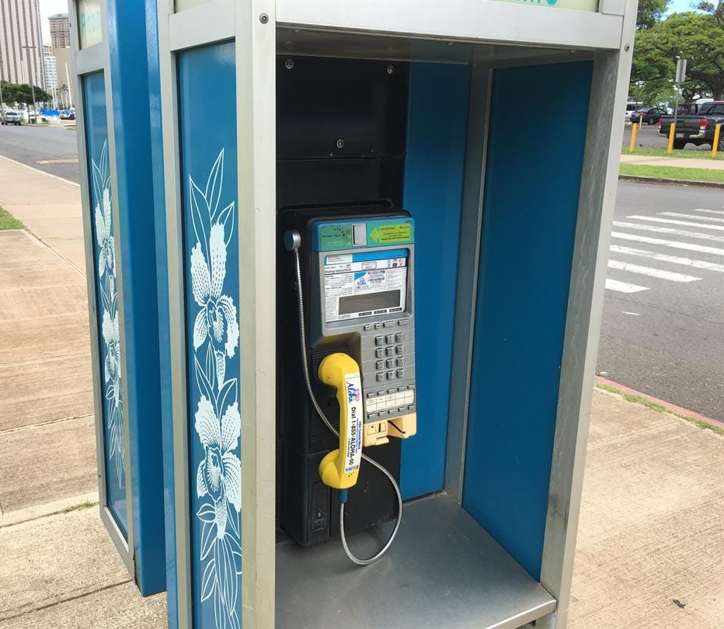
Callbacks
Notes:
Callbacks are another way to use functions.

Slide 8
Some Background
Functions in JavaScript are objects
Just like numbers, strings, etc
Because of this, developers can use them as parameters
Any function that is passed as an argument, and subsequently called by the function that receives it, is called a callback function
Notes:
So, what is a callback? First, let’s talk about JavaScript background.
Functions are objects
Functions can be parameters to other functions
When a function is a parameter, it is called a callback

Slide 9
Why use callbacks?
Callbacks are a way to make sure certain code doesn’t execute until other code has already finished execution.
Developers use callbacks to deal with a number of situations:
Click Handling
Web Requests
Database Queries
Notes:
There are many reasons to use callbacks. It will be necessary for our full-stack web development projects whenever we want to do anything on command.

Slide 10
Example – A function with a callback
function runFunction(callback) {
callback();
}
callback is a function
It is a parameter for runFunction
Notes:
Now let’s look at an example.
The runFunction function has a parameter that is a function. In the body of the function, the callback is called.

Slide 11
Example – Using runFunction
function runFunction(callback) {
callback();
}
function sayHi() {
console.log("hi");
}
runFunction(sayHi);
What will happen?
Notes:
“hi” will be printed to the console.
Click the link to open a REPL and see the code in action.
In the REPL, add another `callback()` to the body of the `runFunction` function to see what happens!

